Slide 1


Computer Workshop
Git
Dr. MalekiMajd
Notes:
- Greet and welcome the new students
- Ask if there are any non-new students

Slide 2
End Goals
Get fluent in the Git version control workflow
Get more used to using the command line
Basic Git proficiency

Slide 3
What is version control?
Version control, also known as source control is the practice of tracking and managing changes to software code.
Enables the developer to revert the changes to their code if any error occurs.
Makes the process of working together as a team without hassle and problems

Slide 4

What is Git?
Git is widely used and actively maintained version control software originally developed by Linus Torvalds.
A staggering number of software projects rely on Git for their version control. Including commercial projects and open-source projects.

Slide 5
Why should you use Git?
Software development teams prefer Git over other version control systems, like CVS, Mercurial, and Perforce, because Git has the adaptability, speed, and stability required.
Nearly everything is stored locally in Git.
Over 87.2% of the developers use Git for Version control.

Slide 6
Getting started
Download and install Git from https://git-scm.com/downloads
Make sure the git command is added to PATH and can be ran from the command line.

Slide 7
Creating your first repository
A repository is the most basic element of Git. It's a place where you can store your code, your files, and each file's revision history.
Creating a Git repository is as simple as running the following command in your directory:
git init

Slide 8
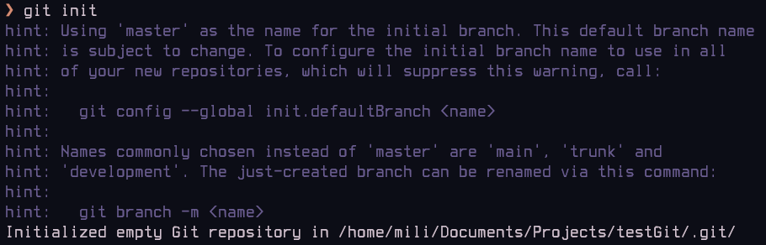

Slide 9
The .git directory
After creating your first folder, you might notice that git has now created a hidden directory called .git
This folder contains all the information that Git needs to track the changes in your codebase.

Slide 10
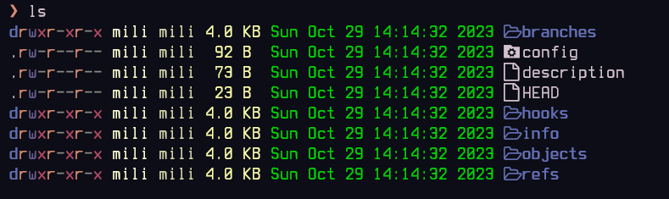

Slide 11
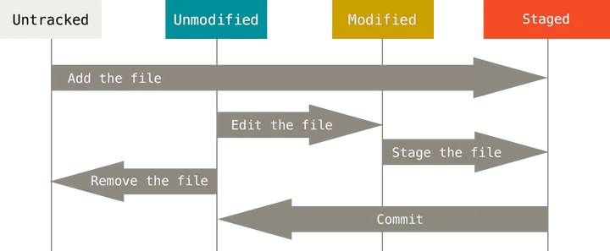
The Three Stages of Git

Slide 12
Note
Before getting into the commands it is worth noting that:
  Each command can have many options, these can be found out by using the official git documentation for that specific command.
  Each student is recommended to see the options after learning this topic for more efficiency

Slide 13
Adding files to project
First step after creating your project is to make the files ready to be committed
This process is generally called staging the files
This can be done using the following command:
git add

Slide 14

Demo
Adding the files in the project we initialized:
Creating a file called
“file1”
Adding the file to our
project

Slide 15
Checking the status of our repository
After staging the files, we can check the status of our repository:
git status

Slide 16
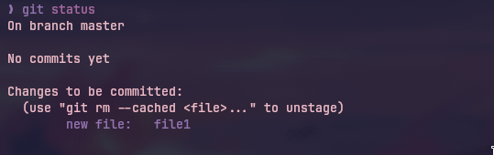
Demo

Slide 17
Commits
Committing in git is essentially making a snapshot of the current state of the project. Or in simpler terms, saving the changes of the staged files.
Git does not duplicate old files (unlike some other version controls) rather save the changes from the last commit.
Files have to be staged to be committed to the repository

Slide 18
Commit metadata
Each git commit holds the following information:
  A snapshot of the project
  Commit message
  Author information
  Timestamp
  Unique SHA-1 Hash
  The changes in the project (changeset)

Slide 19
Creating your first commit
After staging the changes in your project, you can commit your changes using the following command:
git commit

Slide 20
But one more thing!
As a rule of thumb you should always include a message in your commit to indicate what has happened.
You should use descriptive commit messages to make others aware of what has changed in your commit.
You can add commit with Title and Description using the following command:
git commit -m “Title” -m “Description”

Slide 21


Demo
Committing the new change in our demo project:

Slide 22
List commits
In order to list all recent commits use the command down bellow
Note that this command can be more advanced if you take a look at the documentation of the command
git log

Slide 23
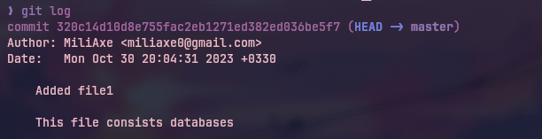
Demo
Hash of the commit

Slide 24
Committing a modified file
Imagine we have modified one of the source codes of our project and we want to commit the changes to that file
As discussed, we have to stage the changes and then commit as normal

Slide 25
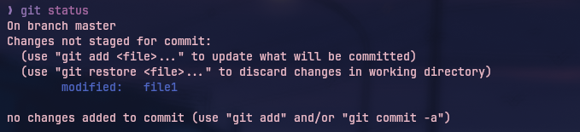
Demo
Editing the file we just created:
Checking the status of our repository

Slide 26
Demo
Staging the changes
Committing the staged change

Slide 27
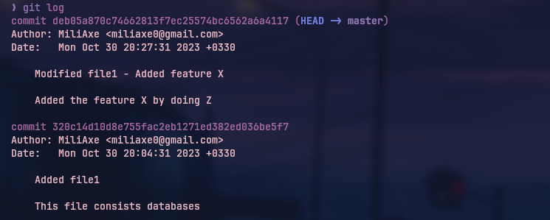
Demo
Seeing the latest changes

Slide 28
Quickly committing all the changes
There is also a quick way to automatically stage all the modified changes without needing to use the git add on all the files
This might not be optimal if you don’t want to save the changes of some files
git commit -a -m “Title” -m “Description”

Slide 29
More commit details
In order to see more details on a specific commit use the following command
This command also shows what has been modified in the commit files.
git show <commit hash>

Slide 30
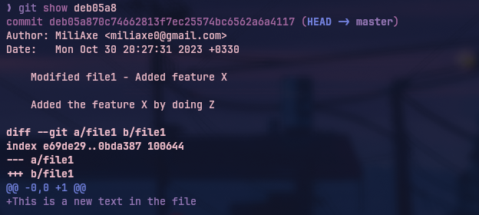
Demo

Slide 31

Modifying… again
Let’s Make another modification to file1:
This time we are going to delete the first line and replace it with another line

Slide 32
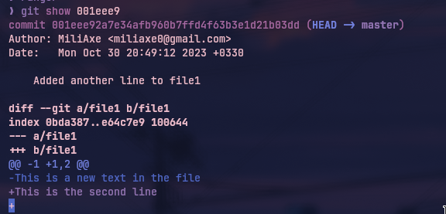
New changes
Now let’s see how well the git show shows the changes:

Slide 33
Changes between multiple commits
Now let’s see how we can use a new command called git diff to see how many changes we’ve had since the start of our little project.
Note that this command can have many options, it can show the changes in one commit as well. Refer to git documentation for more detail.

Slide 34
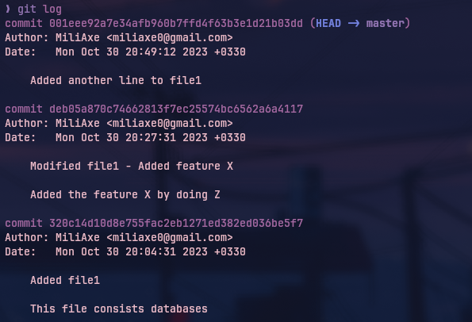
Demo

Slide 35
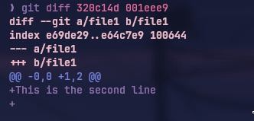
Demo

Slide 36
Branches
In the context of Git, a branch is a fundamental concept that plays an essential role in organizing and managing your project's development. But what exactly is a branch?
Branch is like a separate line of development that allows you to work on a specific set of changes, features, or bug fixes without directly affecting the main codebase.

Slide 37
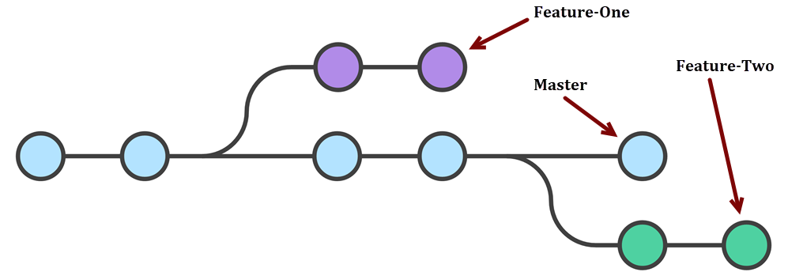
Branches visualized

Slide 38
Branches
Think of branches as separate "sandbox" areas where you can experiment, make modifications, and implement new features, all without disturbing the stability of your main project.
The concept of branching is one of Git's most powerful features, as it empowers developers to work efficiently, collaborate seamlessly, and experiment with new ideas while maintaining a well-organized version history.

Slide 39
Why use branches?
Reasons include:
  Parallel Development
  Isolation
  Experimentation
  ...

Slide 40
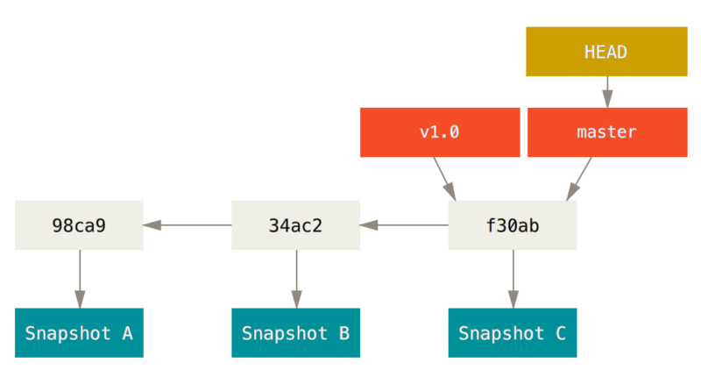
HEAD
HEAD refers to the current position you are in Git.

Slide 41
Create a new branch
In order to create a new branch from the current location, use the following command:
In order to list all the current branches, use the command below:
git branch <branch name>
git branch

Slide 42

Demo
Adding a new branch called “testing” to our demo project:

Slide 43
Moving around
In order to move between commits and branches, the following command can be used:
git checkout <branch name>
git checkout <commit hash>

Slide 44


Demo
Let’s switch to our new branch and make a commit on it

Slide 45

Demo
Let’s go back to the master branch and make some little changes

Slide 46
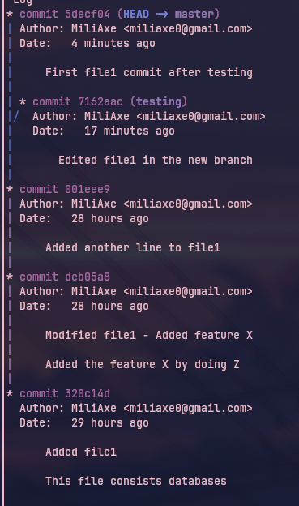
The current status
After these edits on the project,
this will be the log of our project:

Slide 47
A faster way to create a branch
There is a quick way to make a branch and switch to it in one go!
The following command creates a branch from the place HEAD is pointing at and switches to that branch.
git checkout -b <branch name>

Slide 48
Demo
Let’s create a branch from the first commit and make a commit on that branch:
  Navigate to first commit
  Create a branch on first commit and point HEAD to the new branch
  Make changes and commit the changes

Slide 49
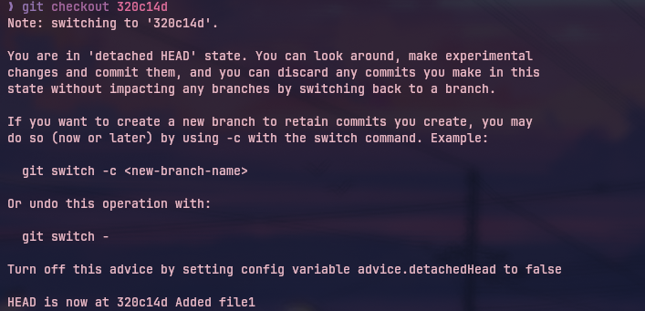
Demo

Slide 50
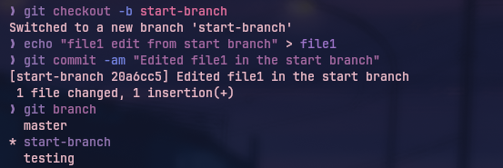
Demo

Slide 51
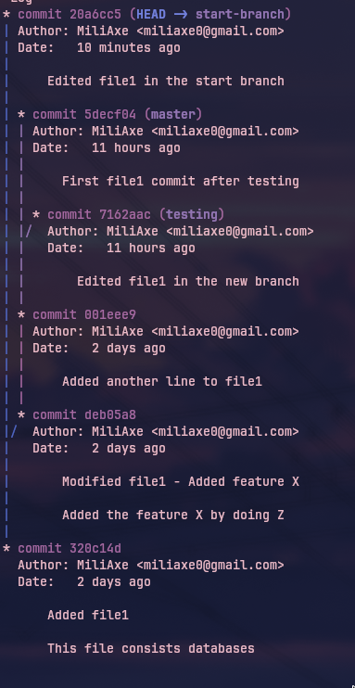
Current status after all the changes:

